Slide 1

The CEFR Companion Volume:
Resources and their use in professional development programmes
CEFR Companion Volume implementation toolbox
Boîte à outils pour la mise en œuvre du volume complémentaire du CECR
© 2023. This work is licensed under an Attribution-NonCommercial-ShareAlike International Creative Commons CC-BY-NC-SA 4.0 License. Attribution: Original activity from Fischer Johann (et al.) (2023), CEFR Companion Volume implementation toolbox, Council of Europe (European Centre for Modern Languages), Graz, available at www.ecml.at/companionvolumetoolbox.

Slide 2
CEFR Companion Volume resources
The CEFR Companion Volume: the published text
The online database of descriptors
The Council of Europe CEFR website

Slide 3
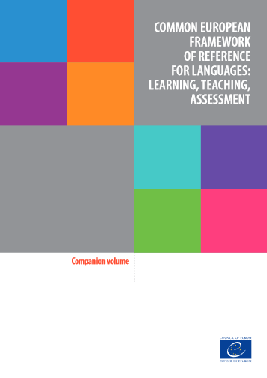
CEFR Companion Volume resources
The CEFR Companion Volume: the published text
The online database of descriptors
The Council of Europe CEFR website

Slide 4
The CEFR and the CEFR Companion Volume: a framework for teaching, learning and assessment
represents:
a framework
general guidelines
not prescriptive
requires:
putting into practice
adapting to individual contexts
developing context-related programmes, curricula, tasks & activities
here:
applying it to university and vocational training contexts

Slide 5
The CEFR and the CEFR Companion Volume: a framework for teaching, learning and assessment
applying it to university and vocational training contexts, i.e.
  selecting the aspects relevant in the specific context
  developing curricula suitable for this context
  addressing respective mode(s) of communication
  selecting and using relevant scales and descriptors
  developing scenarios, tasks, activities for teaching, learning and assessment
  piloting, revising, optimising…
  trying out new approaches

Slide 6
The CEFR and the CEFR Companion Volume: a framework for teaching, learning and assessment
CEFR (2001: 1):
The Common European Framework provides a common basis for the elaboration of language syllabuses, curriculum guidelines, examinations, textbooks, etc. across Europe.
CEFR Companion Volume (2020: 29):
However, it is important to underline once again that the CEFR is a tool to facilitate educational reform projects, not a standardisation tool. Equally, there is no body monitoring or even co-ordinating its use. The CEFR itself states right at the very beginning:
One thing should be made clear right away. We have NOT set out to tell practitioners what to do, or how to do it. We are raising questions, not answering them. It is not the function of the Common European Framework to lay down the objectives that users should pursue or the methods they should employ. (CEFR 2001, Notes to the User)

Slide 7
Professional development activities based on the theoretical framework of the CEFR Companion Volume
Possible professional development workshop activities: reflection tasks
Teacher educators may invite participants to discuss the following aspects after familiarising themselves with the CEFR Companion Volume:
relevant aspects of the CEFR Companion Volume?
aspects that are less relevant in their specific contexts?
new aspects they might want to investigate further or try out?
impact on curriculum design?
impact on assessment?

Slide 8
The CEFR Companion Volume: the theoretical framework
Chapter 2 “Key aspects of the CEFR for teaching and learning”:
introduction to the action-oriented approach and its key features (only 18 pages!)
presentation of new aspects of the CEFR Companion Volume
introduction to the four modes of communication
focus on plurilingual and pluricultural competence
ideas on how to use the illustrative descriptors and how to implement the new framework

Slide 9
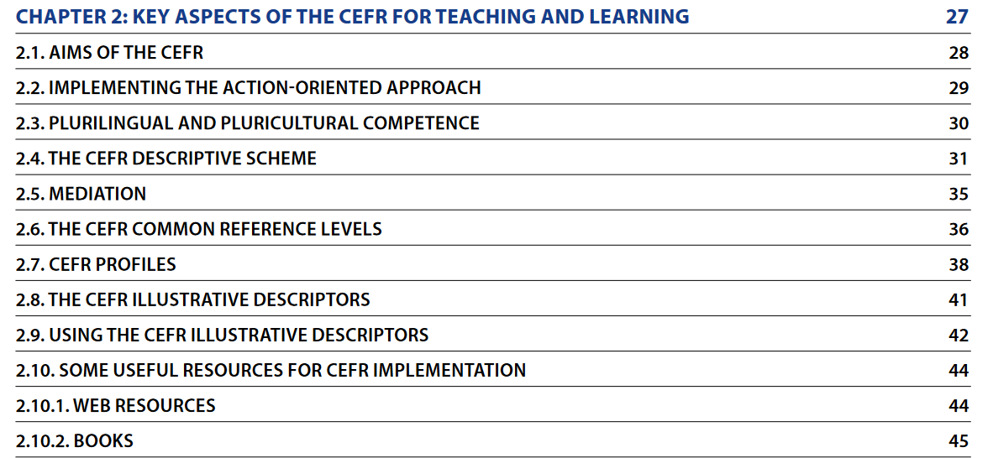
The publication itself: theoretical framework
Chapter 2:

Slide 10
Professional development activities based on Chapter 2 of the CEFR Companion Volume
Possible professional development workshop activities:
Pre-task: invite participants to read chapter 2 of the CEFR Companion Volume
Reflection tasks during the workshop: You may discuss certain aspects presented in chapter 2 (see examples on following slide)

Slide 11
Reflection tasks concerning the theoretical framework
Possible reflection activities:
How does the action-oriented approach impact
  our teaching?
  our approach to testing and assessment?
What is the impact of the concept of the four modes of communication on curriculum design / on assessment?
In which way can we enhance plurilingual and / or pluricultural competence? And how can we integrate these competences in our curriculum?

Slide 12
Useful links and resources
Theoretical aspects:
Council of Europe (2020): Common European Framework of Reference for Languages: Learning, Teaching, Assessment. Companion Volume. Strasbourg: Council of Europe.
https://rm.coe.int/common-european-framework-of-reference-for-languages-learning-teaching/16809ea0d4
(See in particular: Chapter 2 “Key aspects of the CEFR for teaching and learning”, pages 27-45.)
Piccardo, Enrica / North, Brian (2019): The Action-oriented Approach. A Dynamic Vision of Language Education. Bristol: Multilingual Matters.

Slide 13
CEFR Companion Volume resources
The CEFR Companion Volume: the published text
The online database of descriptors
The Council of Europe CEFR website

Slide 14
The online database of descriptors
The Council of Europe provides a link to the database of all descriptors listed in the CEFR Companion Volume in the form of a spreadsheet:
https://rm.coe.int/cefr-descriptors-2020-/16809ed2c7

Slide 15
The online database of descriptors
This spreadsheet allows users to view and to select the descriptors that might be relevant in their context:
It allows
to select the descriptors of a specific level
to choose the mode of communication,
the activity, strategy or competence
the scale
and finally the relevant descriptor(s)

Slide 16
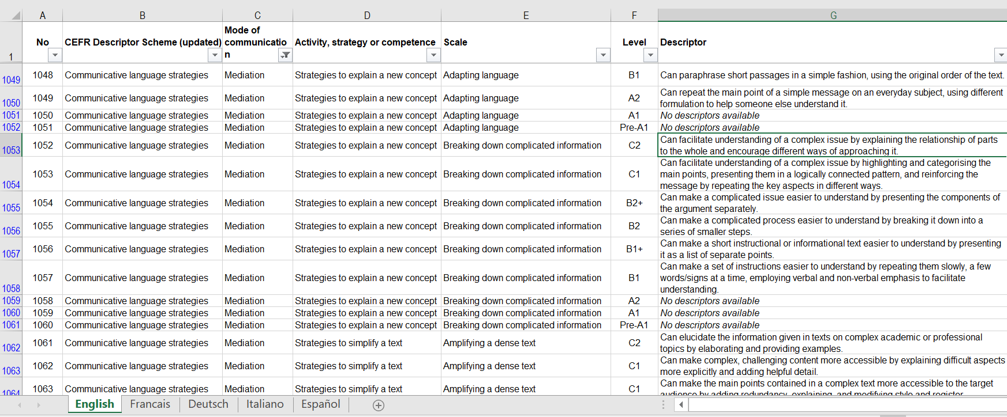
Example showing descriptors for mediation (all levels, activities / strategies / competences, and scales):

Slide 17
Possible professional development workshop activity using the online database
Task:
“Please develop a classroom activity for you specific context using the CEFR descriptors.
Please choose the target level of your group, then select the mode of communication you want to address, and then the activity, strategy or competence, then the scale and finally the relevant descriptor(s). In a second step please develop a classroom activity, task or project that addresses this descriptor (these descriptors).”

Slide 18
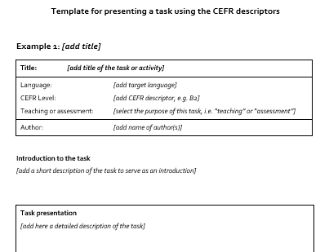
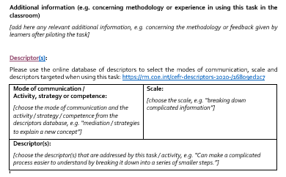
Possible professional development workshop activity using the online database
Template for task development / description, which allows for:
illustrating examples of good practice produced by the participants and
providing ideas for colleagues

Slide 19
CEFR Companion Volume resources
The CEFR Companion Volume: the published text
The online database of descriptors
The Council of Europe CEFR website

Slide 20
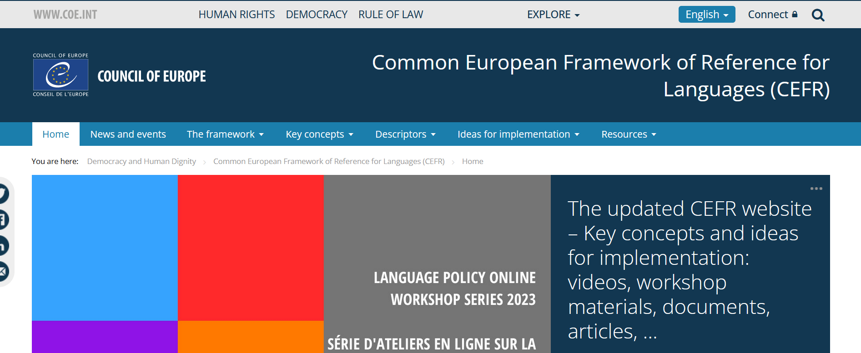
The Council of Europe CEFR website
The Council of Europe has set up a website which provides a large database of resources concerning the CEFR and the CEFR Companion Volume:
https://www.coe.int/en/web/common-european-framework-reference-languages

Slide 21
The Council of Europe CEFR website
This website offers e.g. access to:
online publications of the CEFR and the CEFR Companion Volume,
but also publications covering specific aspects e.g. on how to use these resources,
videos presenting the key concepts of the CEFR Companion Volume,
recorded webinars
ideas for implementation
the database of descriptors

Slide 22
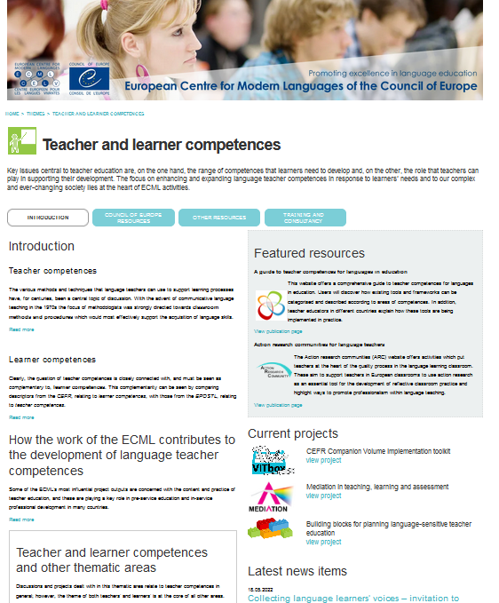
The ECML website
The ECML website provides valuable tools relating to the use of the CEFR and the CEFR Companion Volume

Slide 23
The Council of Europe and the ECML websites
Both websites offer
resources addressing specific aspects of the CEFR and the CEFR Companion Volume,
their implementation,
as well as examples of good practice
→ useful tools for professional development workshops!

Slide 24
List of resources
Council of Europe CEFR website:
https://www.coe.int/en/web/common-european-framework-reference-languages
Council of Europe (2001): Common European Framework of Reference for Languages: Learning, teaching, assessment. Cambridge: CUP; English text available at:
https://rm.coe.int/1680459f97
Council of Europe (2020): Common European Framework of Reference for Languages: Learning, Teaching, Assessment. Companion Volume. Strasbourg: Council of Europe; English text available at:
https://rm.coe.int/common-european-framework-of-reference-for-languages-learning-teaching/16809ea0d4.
Council of Europe (2020): CEFR Descriptors (searchable database of descriptors):
https://rm.coe.int/cefr-descriptors-2020-/16809ed2c7.
Piccardo, Enrica / North, Brian (2019): The Action-oriented Approach. A Dynamic Vision of Language Education. Bristol: Multilingual Matters.
European Centre for Modern Languages: VITbox Resources, available at:
www.ecml.at/companionvolumetoolbox.

